Slide 1
Web Phishing Detection
Team ID : PNT2022TMID50730
Team Leader : TAMIL SELVI M (953119104045)
Team member : ARUNMOZHI N (953119104004)
Team member : JEYASRI T (953119104015)
Team member : MARISELVI P (953119104027)

Slide 2
Pre-Requisites
In order to develop this project we need to install the following software/packages :
Step 1:
Anaconda Navigator is a free and open-source distribution of the Python and R programming languages for data science and machine learning related applications. It can be installed on Windows, Linux, and macOS. Conda is an open-source, cross-platform, package management system. Anaconda comes with great tools like JupyterLab, Jupyter Notebook, QtConsole, Spyder, Glueviz, Orange, Rstudio, Visual Studio Code. For this project, we will be using Jupyter notebook and Spyder .

Slide 3
Step 2:
To build Machine learning models you must require the following packages
Open anaconda prompt.
Type “pip install numpy” and click enter.
Type “pip install pandas” and click enter.
Type “pip install matplotlib” and click enter.
Type “pip install scikit-learn” and click enter.
Type “pip install Flask” and click enter.

Slide 4
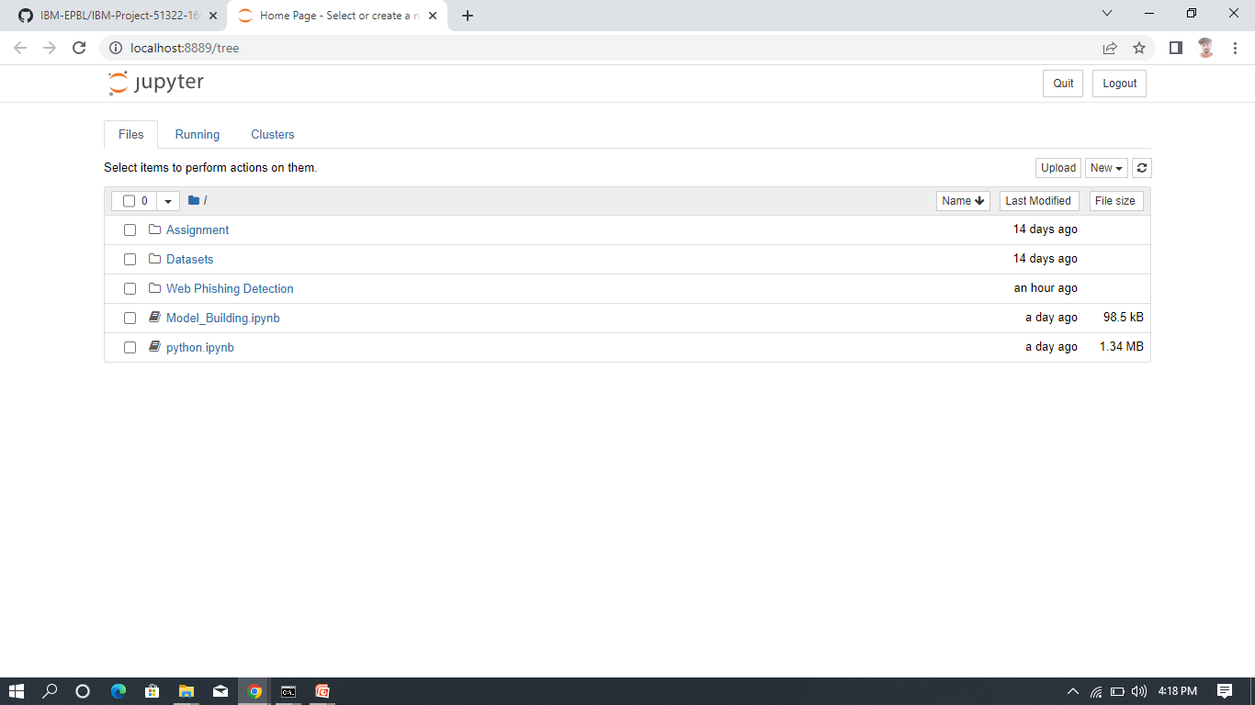

Slide 5
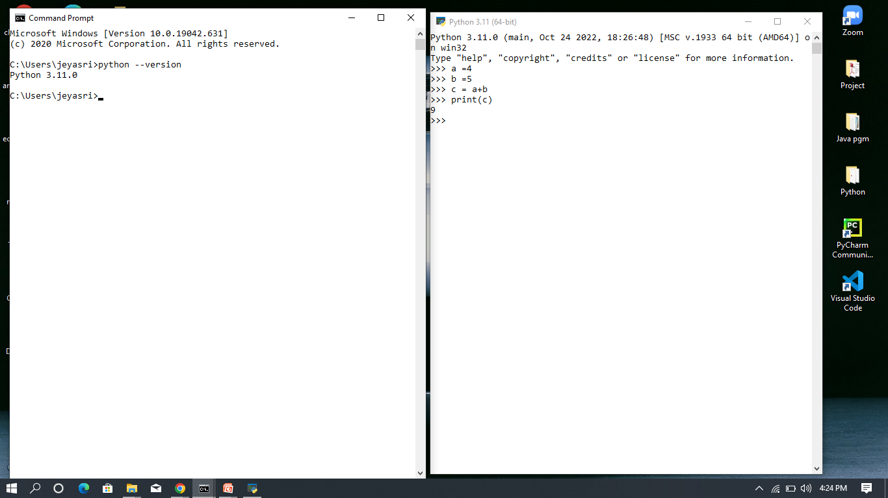

Slide 6
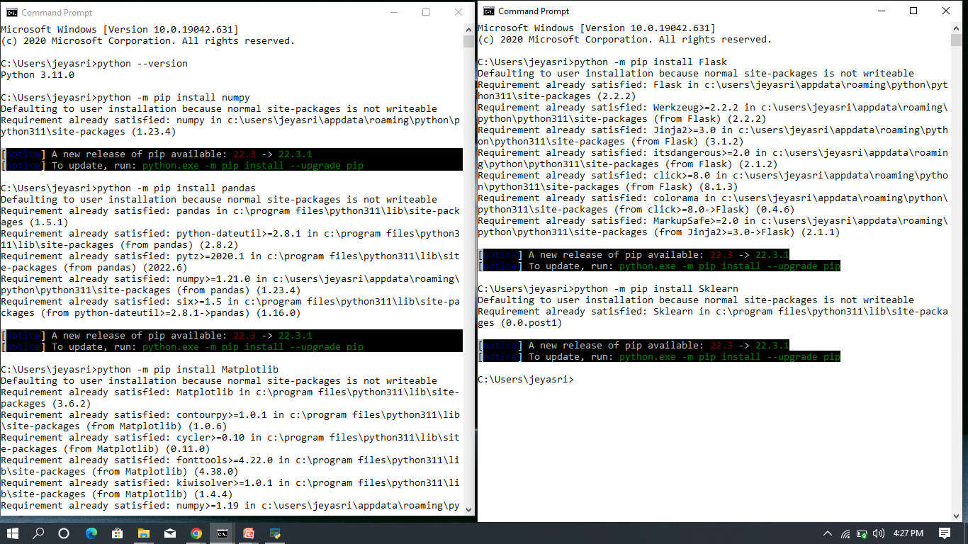

Slide 7
Conclusion
The final take away form this project is to explore various machine learning models, perform Exploratory Data Analysis on phishing dataset and understanding their features. Creating this notebook helped me to learn a lot about the features affecting the models to detect whether URL is safe or not, also I came to know how to tuned model and how they affect the model performance .The final conclusion on the Phishing dataset is that the some feature like "HTTTPS", "AnchorURL", "WebsiteTraffic" have more importance to classify URL is phishing URL or not

